Slide 1


Mapping
COMSM4111 Robotic Systems
Anonymous Feedback form:
https://forms.gle/PyQQy2mwzyATFmJW6
Padlet board (questions & comments):
http://padlet.com/paul_odowd1/1lhoodwv2fuc
Delivered by:
Paul O’Dowd paul.odowd@bristol.ac.uk

Slide 2
House Keeping
~60 People Assessed yesterday – well done, thank you!
Next weeks sign-up.
Group Declaration on BB.

Slide 3
Lab Sessions / Sheets
Week 1
Week 2
Week 3
Week 4
Week 5
Week 6
Week 7
Meet the Romi
Millis()
Encoders
PID
Line Following
Finite State Machine
Motors
Time & Speed
Kinematics
Lectures
Intro
Sensors & Actuators
Feedback Control 2
Probabilistic Robotics
System
Architectures
Path Planning
Experimental Robotics
Micro-controllers
Feedback Control 1
Kinematics
PID Drop-In
Sensor Fusion
Searching & Mapping
Assessment 2 Briefing
Toward
Assessment 2
Assessment Op 1
Assessment Op 2
Assessment Op 3

Slide 4
Mapping
Mapping Definition
Types of Maps
Key Challenges in Mapping
Measurements
Perceptual Aliasing
Correspondence / Data Association Problem
Example: Particle Filter Localisation
Types of Environments
Example: SLAM
Exploration / Navigation

Slide 5
Mapping: Definition
“Robotic mapping addresses the problem of acquiring spatial models of physical environments through mobile robots.”
Mapping algorithms tend to be greedy – e.g., maximise the discovery of information. (Do we want a slow, or partially mapped space?)
Robot has to move safely/efficiently (navigate, using a map)
Robot has to map (limited perceptual range incurs movement)

Slide 6
Types of Maps
Metric (Grids)
Topographical (Graphs)

Slide 7
A Caveat
Metric maps can be thought of as high-resolution topographical maps.
Or we often use a topographical system to navigate a metric map (waypoints).

Slide 8
A Caveat
Topographical maps often reference metric representation (e.g., where is the vertex/node in a global coordinate system?)
Notes:
Hybrid approaches

Slide 9
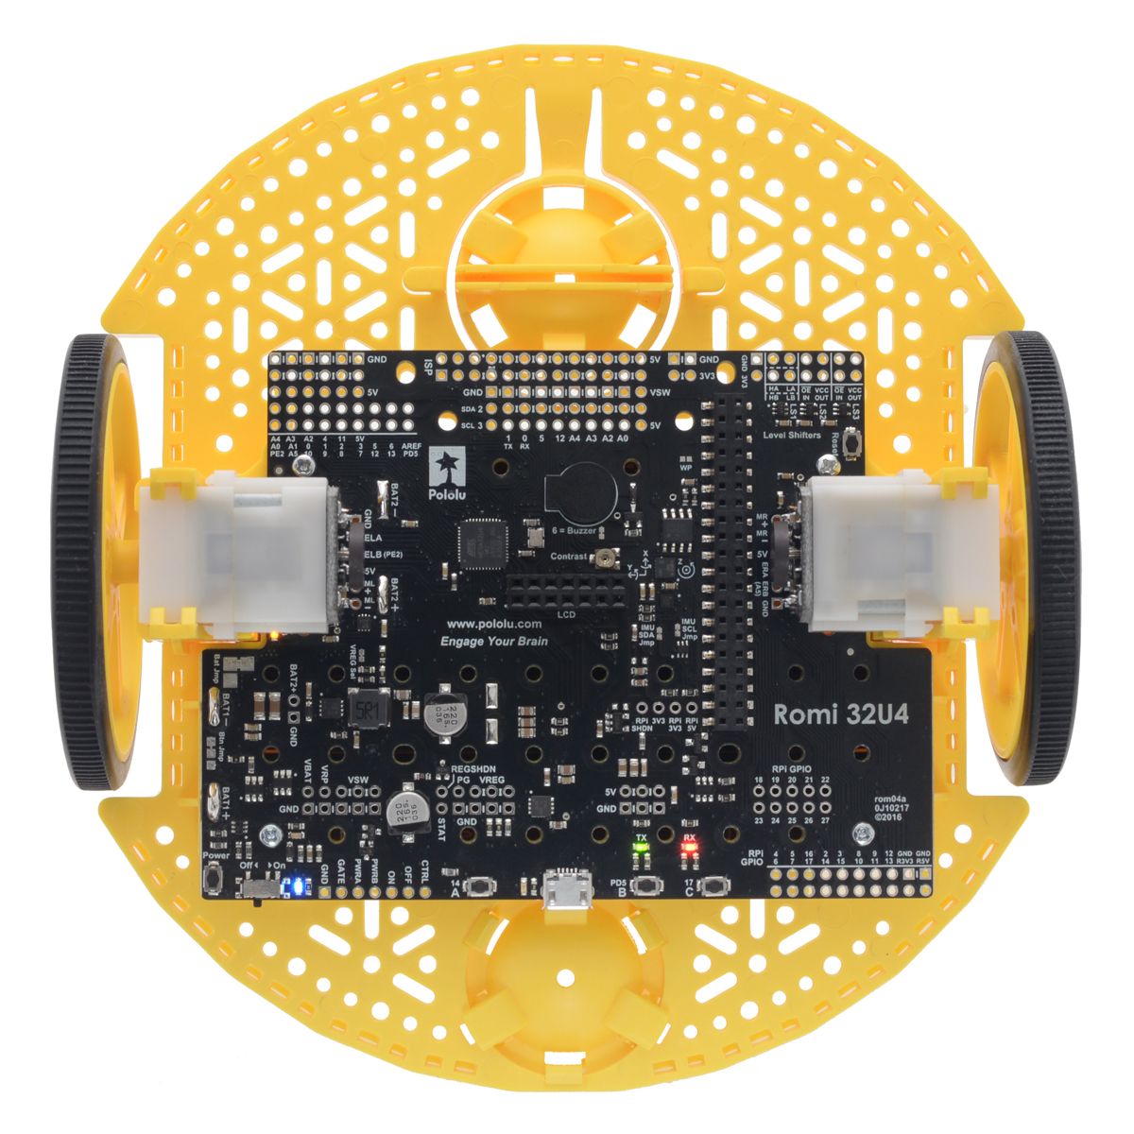
Mobile Robotics Mapping
X = 100
Y = 200
X = -10
Y = 139
?
World-centric
Robot-centric
Sensor-measurements
recorded in global coordinate space.
Objects recorded in global coordinate space.
X = 30
Y = -439
Notes:
Robot-centric: Using sensor-measurements recorded at different locations. If a list of known sensor-measurement locations are known, the approach doesn’t work so well with unknown environments. It is difficult to infer where you are in the gaps between sensor-measurements. However, the approach does work well as a system of landmarks to key localisation.
World-centric – world is “known”, so unknown sensor readings can be extrapolated to a position in the world. However, the world has to be known!

Slide 10
Mapping
Mapping Definition
Types of Maps
Key Challenges in Mapping
Measurements
Perceptual Aliasing
Correspondence / Data Association Problem
Example: Particle Filter Localisation
Types of Environments
Example: SLAM
Exploration / Navigation

Slide 11
Key Challenges in Mobile Robotics Mapping

Slide 12
Measurements
If the robot / object is fixed, we can cancel out the noise.
Measurements would be statistically independent.
Assumption that the localisation is error free.

Slide 13
Measurements
If the robot / object is fixed, we can cancel out the noise.
Measurements would be statistically independent.
Assumption that the localisation is error free.

Slide 14
Measurements
If the robot / object is fixed, we can cancel out the noise.
Measurements would be statistically independent.
Assumption that the localisation is error free.

Slide 15
Measurements
If the robot / object is fixed, we can cancel out the noise.
Measurements would be statistically independent.
Assumption that the localisation is error free.

Slide 16
Mapping: Definition
“Robotic mapping addresses the problem of acquiring spatial models of physical environments through mobile robots.”
Mapping algorithms tend to be greedy – e.g., maximise the discovery of information. (Do we want a slow, or partially mapped space?)
Robot has to move safely/efficiently (navigate, using a map)
Robot has to map (limited perceptual range incurs movement)

Slide 17
Mapping
Mapping Definition
Types of Maps
Key Challenges in Mapping
Measurements
Perceptual Aliasing
Correspondence / Data Association Problem
Example: Particle Filter Localisation
Types of Environments
Example: SLAM
Exploration / Navigation

Slide 18
Perceptual Aliasing
A
B
C
?
How can we know whether the robot is at A, B, or C?

Slide 19

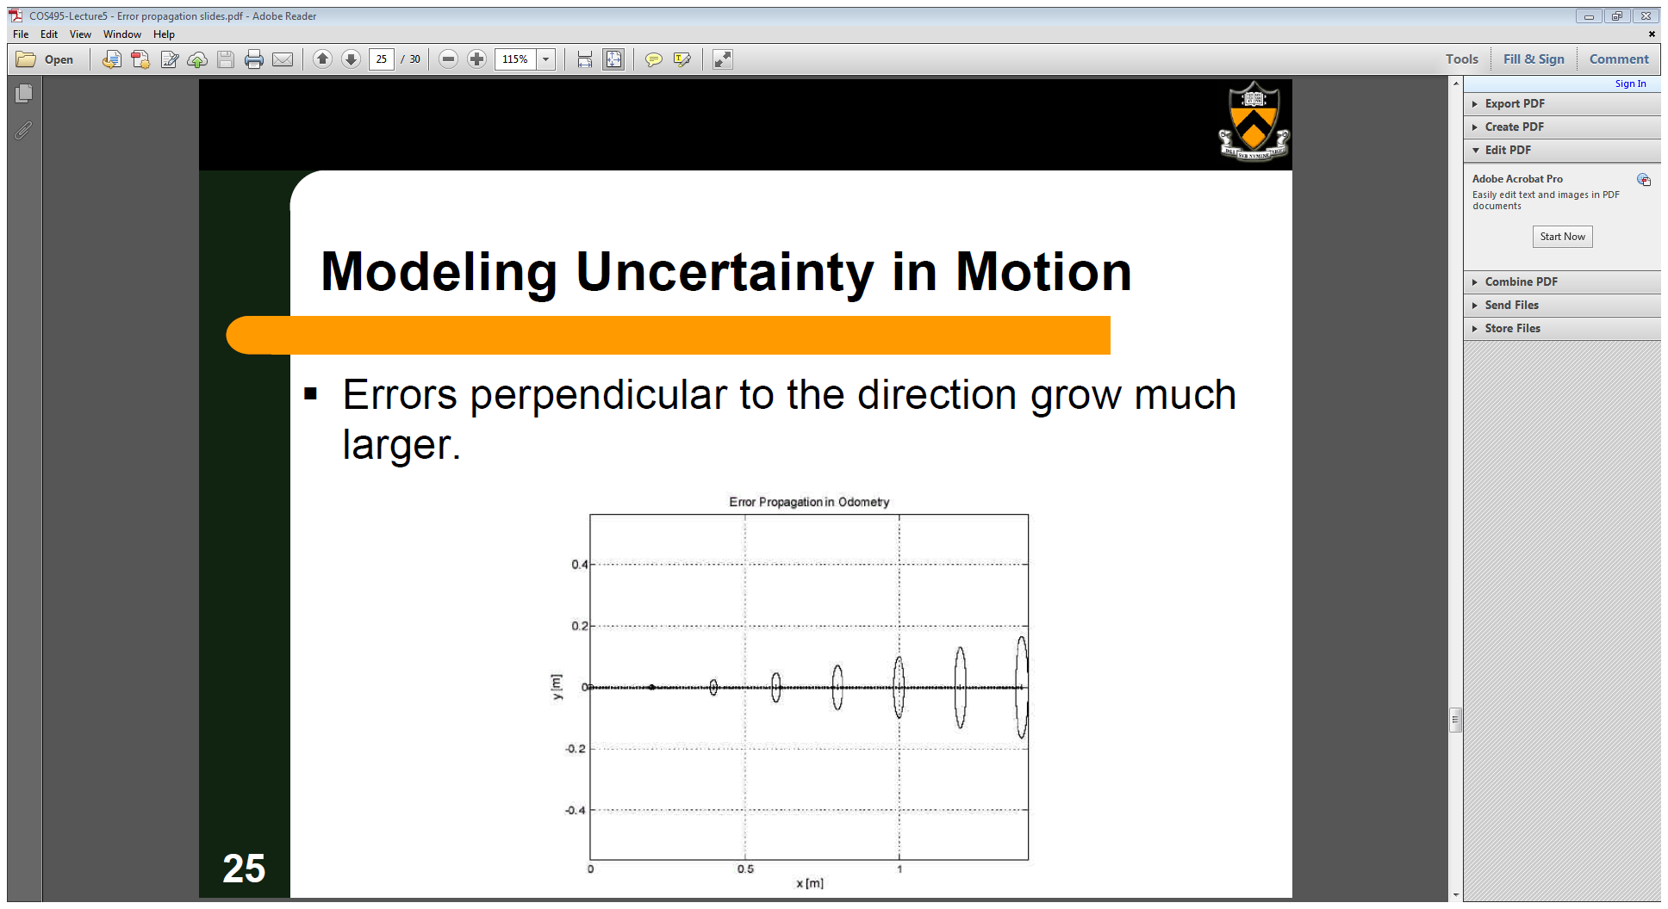
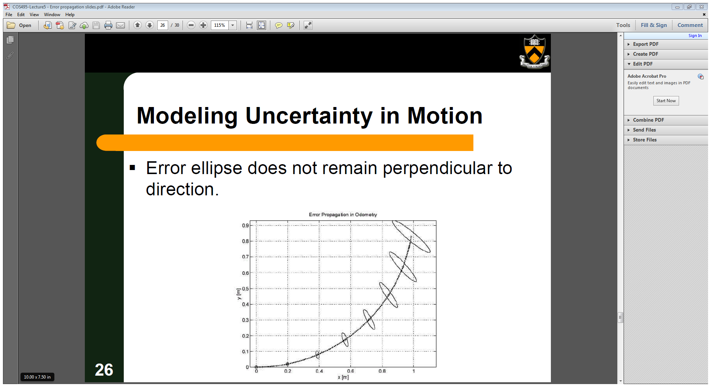
Measurements
Pose Estimation / Localisation is another measurement subject to error.

Slide 20
Measurements
The robot has to move and/or the environment is dynamic.
We need to make inferences from pose and state.
Measurements are effected by control error.
Measurements are statistically dependent.

Slide 21
Mapping
Mapping Definition
Types of Maps
Key Challenges in Mapping
Measurements
Perceptual Aliasing
Correspondence / Data Association Problem
Example: Particle Filter Localisation
Types of Environments
Example: SLAM
Exploration / Navigation

Slide 22
Correspondence / Data Association Problem
“The problem of determining whether sensor measurement recorded at different points in time correspond to the same physical entity in the real world.”
Detected features are correct, but the map is skewed.
Long term accrual of error
Local/Immediate measurements can still be “trusted”, just misplaced.
Expectation-maximisation.
Notes:
Expectation-maximisation

Slide 23
Mapping
Mapping Definition
Types of Maps
Key Challenges in Mapping
Measurements
Perceptual Aliasing
Correspondence / Data Association Problem
Example: Particle Filter Localisation
Types of Environments
Example: SLAM
Exploration / Navigation

Slide 24
Example: Particle Filter Localisation
100
30
10
Sensor measurement “fingerprint”: 100, 30, 10

Slide 25
Example: Particle Filter Localisation
Hypotheses
Many “imaginary robots”
100
30
Simulation Model
10

Slide 26
Example: Particle Filter Localisation
20,50,60
150,80,30
80,60,80
87,55,55
…
…
…
(n)
100
30
Simulation Model
10

Slide 27
Example: Particle Filter Localisation
20,50,60
150,80,30
80,60,80
87,55,55
…
…
…
(n)
100
30
Simulation Model
10

Slide 28
Example: Particle Filter Localisation
Repeat:
Adjust the Hypotheses
Move robots according to control model
Re-evaluate sensors
100
30
Simulation Model
10

Slide 29
Example: Particle Filter Localisation
Repeat:
Adjust the Hypotheses
Move robots according to control model
Re-evaluate sensors
100
30
Simulation Model
10

Slide 30
Example: Particle Filter Localisation
Repeat:
Adjust the Hypotheses
Move robots according to control model
Re-evaluate sensors
100
30
Simulation Model
10

Slide 31
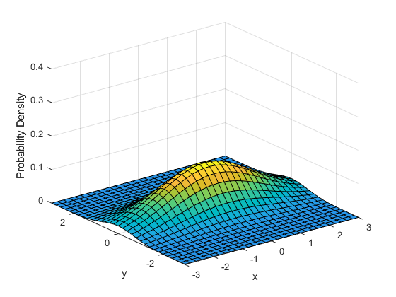
Example: Particle Filter Localisation
Probabilistic Localisation
100
30
Simulation Model
10

Slide 32
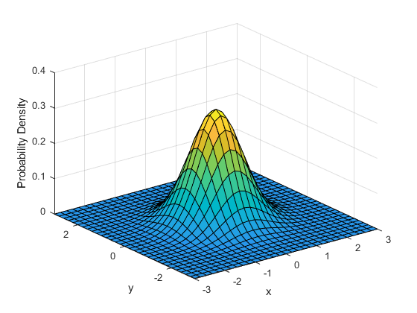
Example: Particle Filter Localisation
Probabilistic Localisation
100
30
Simulation Model
10

Slide 33
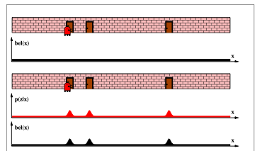
Example: Particle Filter Localisation
Simulation Model

Slide 34
Robotic Mapping
X = 100
Y = 200
X = -10
Y = 139
?
World-centric
Robot-centric
Sensor-measurements
recorded in global coordinate space.
Objects recorded in global coordinate space.
X = 30
Y = -439
Notes:
Robot-centric: Using sensor-measurements recorded at different locations. If a list of known sensor-measurement locations are known, the approach doesn’t work so well with unknown environments. It is difficult to infer where you are in the gaps between sensor-measurements. However, the approach does work well as a system of landmarks to key localisation.
World-centric – world is “known”, so unknown sensor readings can be extrapolated to a position in the world. However, the world has to be known!

Slide 35
Example: Particle Filter Localisation
Probabilistic Localisation
Robot-centric
Measurements.
(dynamic)
World-centric
correlation.
(static)
100
30
Simulation Model
10

Slide 36
Mapping
Mapping Definition
Types of Maps
Key Challenges in Mapping
Measurements
Perceptual Aliasing
Correspondence / Data Association Problem
Example: Particle Filter Localisation
Types of Environments
Example: SLAM
Exploration / Navigation

Slide 37
Types of Environments
Static: Environment is fixed, structured, and of limited size. E.g., a laboratory.
Can “solve mapping” relative to a World-centric localisation.
Dynamic: Environment and robot change over time. E.g., reality.
Mapping relies on exploration, localisation, perception and map construction.

Slide 38
Mapping
Mapping Definition
Types of Maps
Key Challenges in Mapping
Measurements
Perceptual Aliasing
Correspondence / Data Association Problem
Example: Particle Filter Localisation
Types of Environments
Example: SLAM
Exploration / Navigation

Slide 39
Simultaneous Localisation and Mapping (SLAM)
Sensor information
Map Updated
X = 100
Y = 200
Given my location in the map,
what is my pose?
Given my pose,
where am I in the map?
Pose Updated
Map information

Slide 40
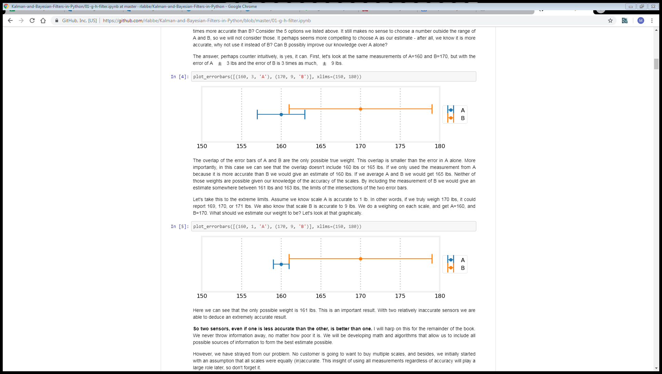
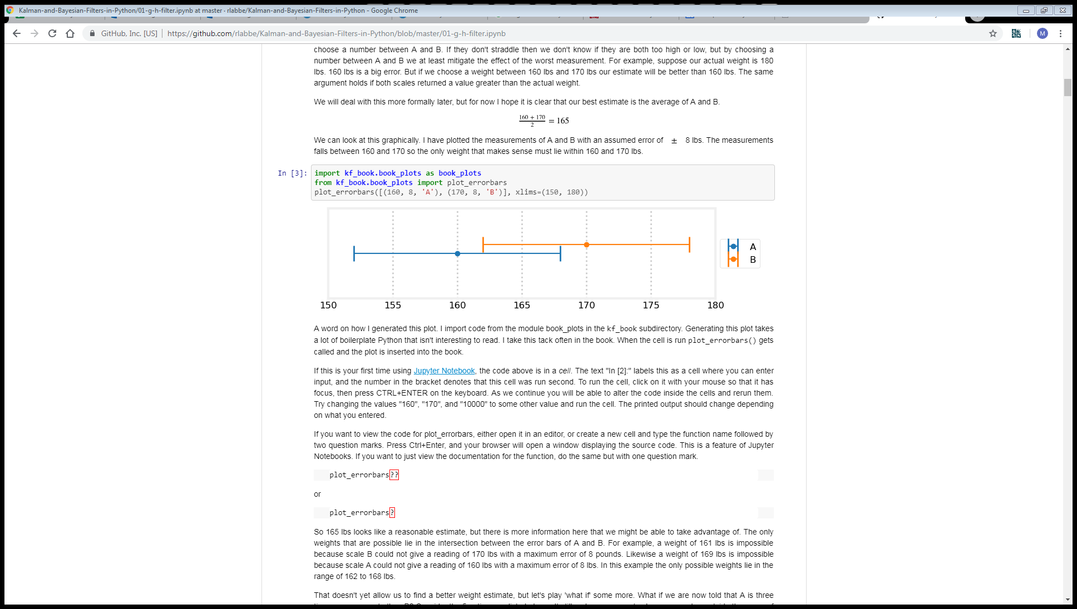
Sensor Fusion
A: Predicted Pose
B: Pose according to map
A: Predicted Map Feature
B: Map Feature according to pose

Slide 41
Mapping
Mapping Definition
Types of Maps
Key Challenges in Mapping
Measurements
Perceptual Aliasing
Correspondence / Data Association Problem
Example: Particle Filter Localisation
Types of Environments
Example: SLAM
Exploration / Navigation

Slide 42
Exploration: Heuristics vs Randomisation
Heuristics:
“rules of thumb”
Wall following
Bug-algorithms
Obstacle Avoidance
Exploration strategies
Task / context dependent
Randomisation:
Low-cost (material, computation)
Some tasks require multiple passes (e.g. de-mining conflict zones).

Slide 43

Exploration: Bostrophedon Planning (Greek, “ox-turning”)
What to do if starting position is not at the edge of the space?
How to efficiently navigate back around obstructions?
3D printing infill algorithms?
http://planning.cs.uiuc.edu/node352.html

Slide 44
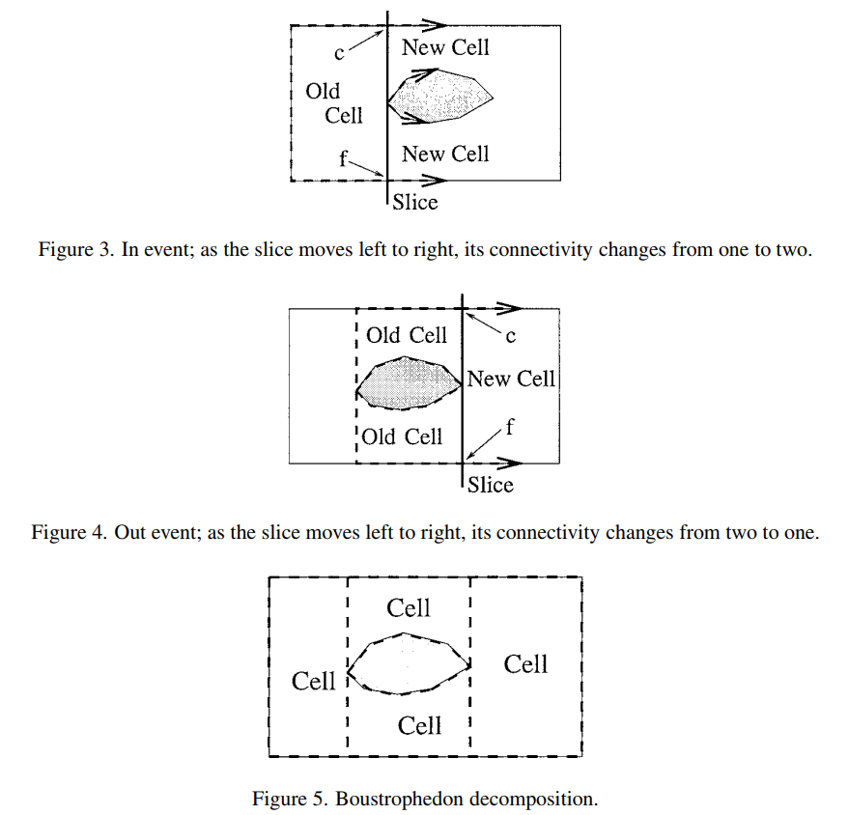
Exploration: Cellular Decomposition, Slab Method

Slide 45
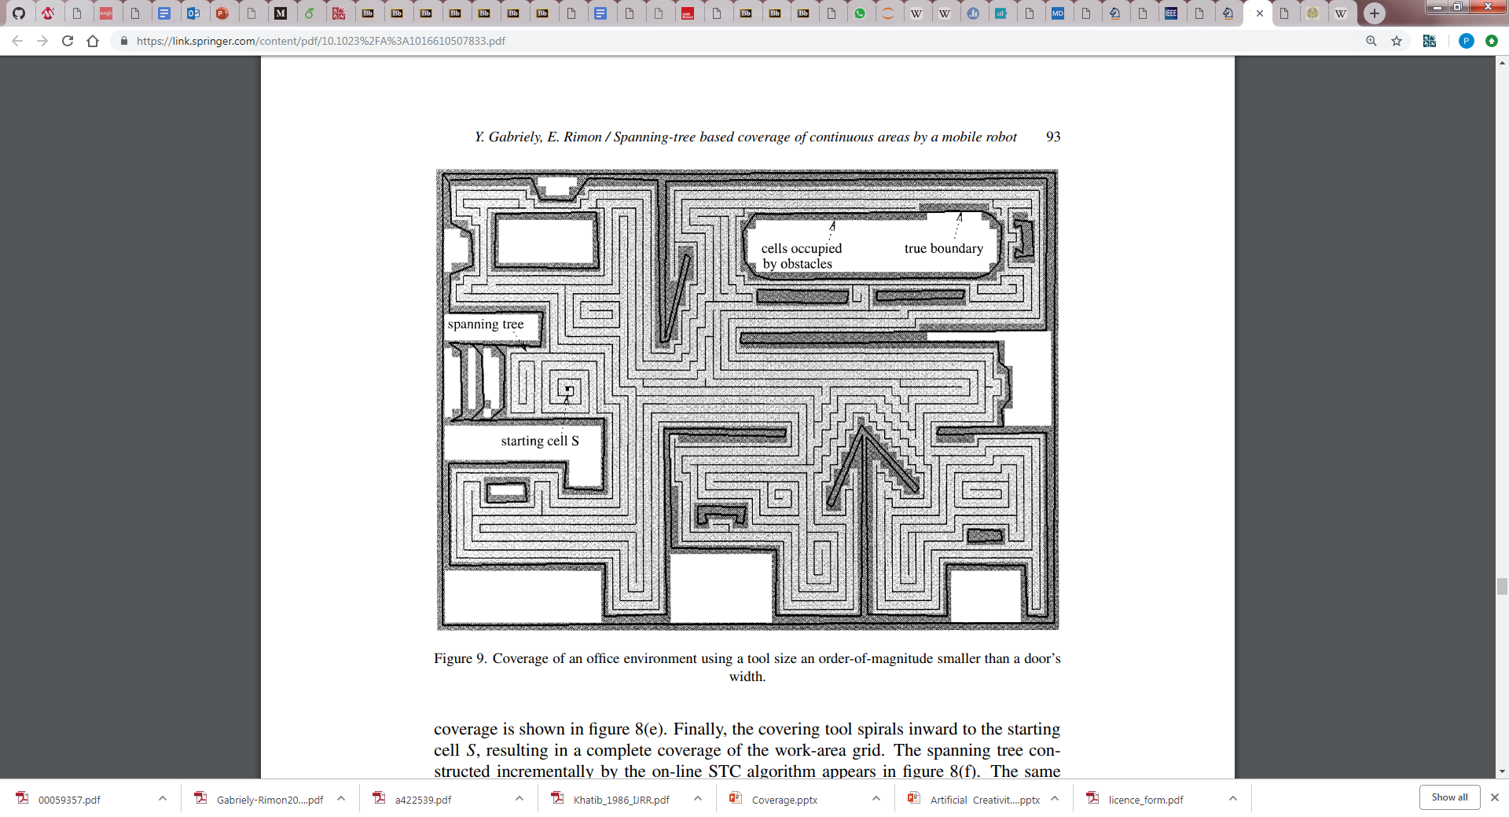
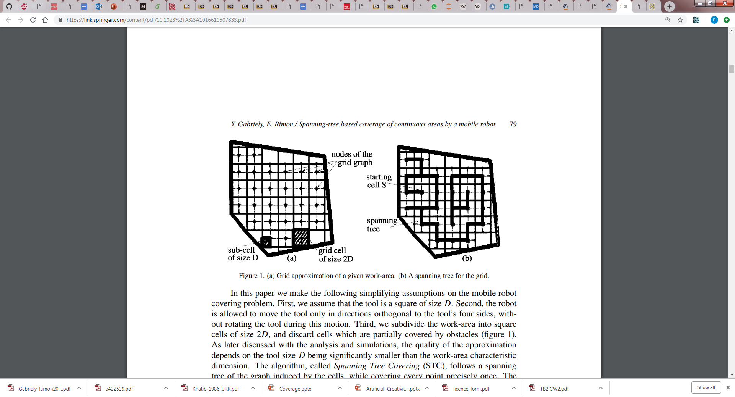
Exploration: Spanning Tree Covering
Y. Gabriely and E. Rimon. Spanning-tree based coverage of continuous areas by a mobile robot. Technical report, Dept. of Mechanical Engineering, Technion, Israel Institute of Technology, December 1999.

Slide 46
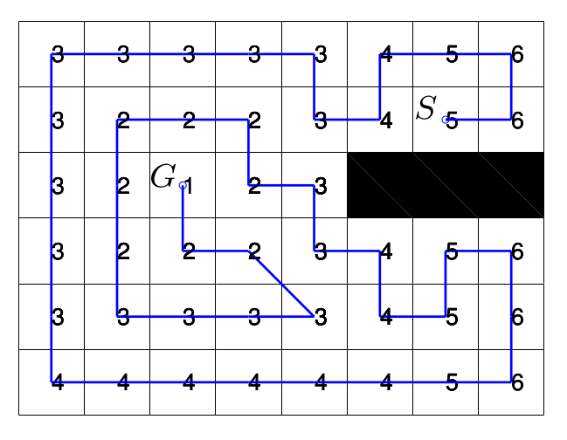
Exploration: Wavefront
Set a start and goal location.
Create a gradient in a metric (grid) representation.
Greedily follow gradient to nearest neighbour, tracking visited cells.
Can be used to keep robot within safe distances of obstacles.
Potentially a path-planning problem (travelling salesman problem)

Slide 47
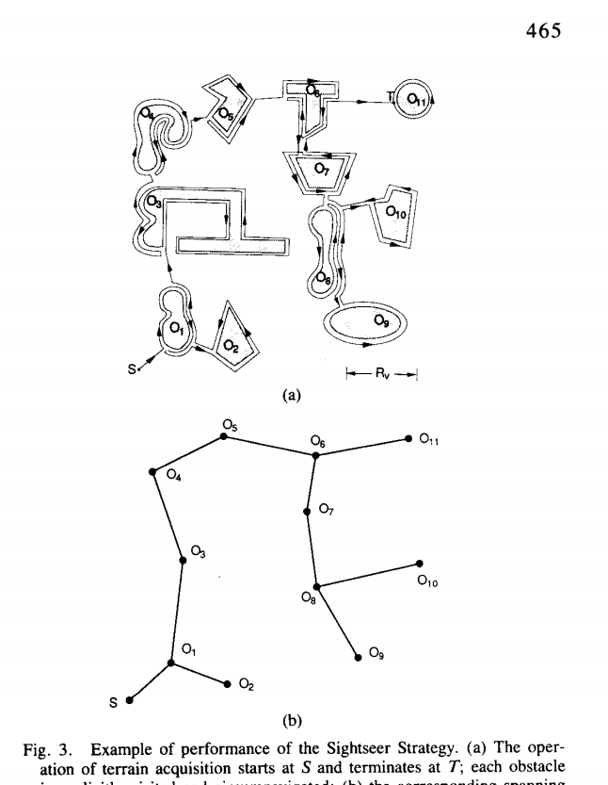
Exploration: Sightseer Strategy
Terrain Acquisition
Attempts to find all objects within an enclosed space
Objects are ‘found’ once fully circumnavigated
Strategies are evaluated on objects found and total path length.

Slide 48
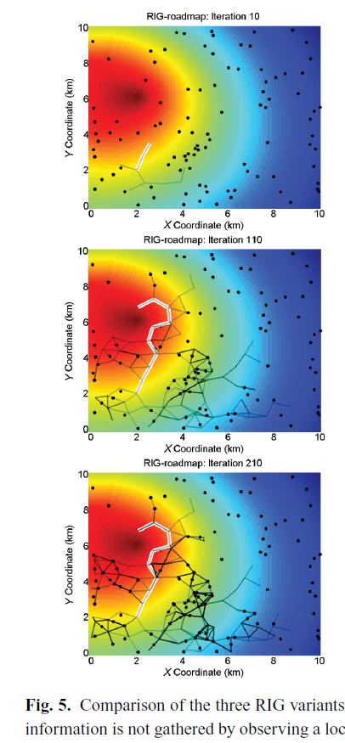
Exploration: Rapid Information Gathering (RIG)
Typically uses PRM, RRT, etc.
Uses an ‘information metric’ to discern areas of interest / unexplored areas.

Slide 49
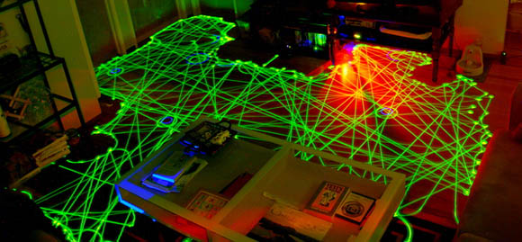
Roomba Path
https://www.cnet.com/news/how-to-choose-the-best-robot-vacuum-for-your-home-roomba-neato-ecovacs-2019/

Slide 50
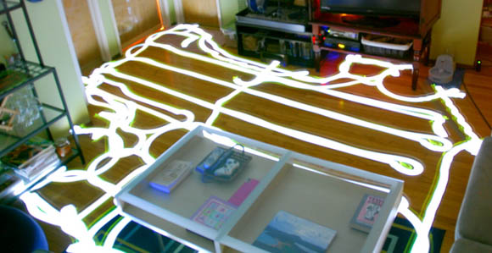
Mint Path

Slide 51
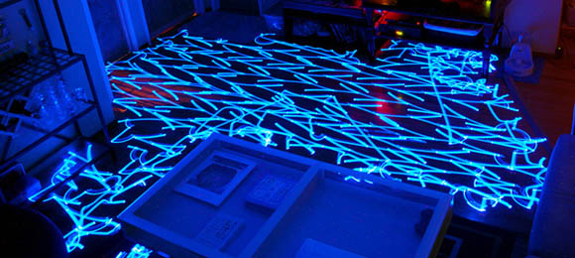
Mint Path (mopping)

Slide 52
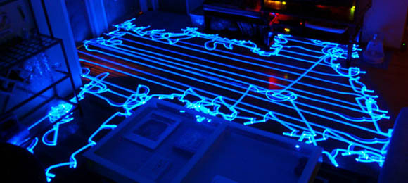
Mint Path (sweep)
https://www.youtube.com/watch?v=SusPRqU2W4M

Slide 53
Mapping
Mapping Definition
Types of Maps
Key Challenges in Mapping
Measurements
Perceptual Aliasing
Correspondence / Data Association Problem
Example: Particle Filter Localisation
Types of Environments
Example: SLAM
Exploration / Navigation

Slide 54
Discussion
Producing / Using a map
Key Challenges in Mapping
Measurements
Perceptual Aliasing
Correspondence / Data Association Problem
Example: Particle Filter Localisation
Types of Environments
Example: SLAM
Exploration / Navigation
Uncertainty / Probability
Information Maximisation
Feature Characterisation
Static / Dynamic Obstacles
Odometry / kinematics
Motion Control
Path Planning
Exploration Strategies

